Slide 1
Iteration 1 CSE 6324-Advance Topic in Software Engineering University of Texas at Arlington (UTA)
Project Title: Smart Contract Analysis and Defect Fixing with Slither.
Team members:
1002031033
1002033432
1002026832
1001965572
1001911486
Shubham Arun Malankar
Nageshwar Ramkumar Jaiswal
Ravi Prakasha
Navyashree Budhihal Mutt
Rushikesh Mahesh Bhagat

Slide 2
Features that we worked on:
Installed and executed Slither on machine, understood the scope for optimization within it. [3]
Discovered and learnt about a performance analyzing tool Snakewiz, using which we calculated execution time of different process within slither.[6]
Tried with libraries like Levenstein, Jellyfish, Fuzzywuzzy, and RapidFuzz, and assessed their impact on runtime.[8]

Slide 3
Approach to optimize Detector
Every solidity smart contract has numerous variables, which are associate with some values.
Having similar variable, increased execution time and impacted on the performance.
After analyzing detector file i.e., similar_variable.py file, we found out that existing libraries and code structure was main reason behind inefficient time execution. [1]

Slide 4
Risks Faced During The Iteration :
Risks: | Type: | Mitigation:
Inadequate Documentation for Slither | Minor | To reduce the likelihood of this risk, seek out additional resources that are encountering similar issues and offering more information.
Slither producing different results on Mac and Windows Operating Systems. | Minor | To mitigate the influence of varying system environments on Slither's analysis, a possible solution is to standardize the environment and employ cross-platform functionality to execute the tool.
Searching for Smart Contracts that are compatible | Major | After extensive research, found a repository containing real-time contracts of sufficient size to evaluate the detector's performance. [7]
Loss of Functionality while optimizing the detector | Major | Used similar library to test various bugs and ensured the vulnerabilities detected was equivalent to the existing library used in slither. [2]

Slide 5
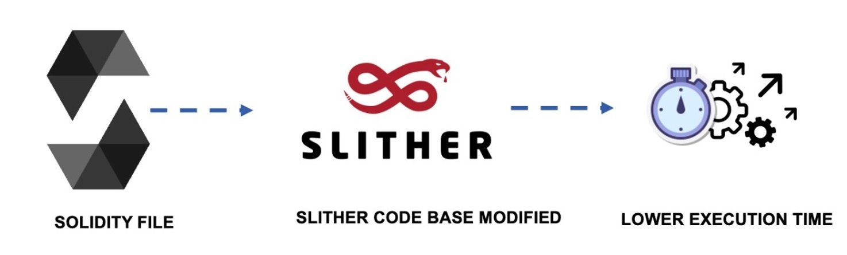
Design and Specification
Fig.1 Workflow Diagram [4]
List of Inputs
Solidity files. [7]
List of Output
Vulnerabilities present in contract.
Graphical representation of overall runtime.[6]

Slide 6
Tool and Technologies:
Visual Studio Code [12]
Python 3.9.7 [10]
Jellyfish - 0.9.0 [5]
Slither-Analyzer - 0.9.2 [3]
Snakeviz - 2.1.1 [6]
Solc-Select - 1.0.3 [3]

Slide 7
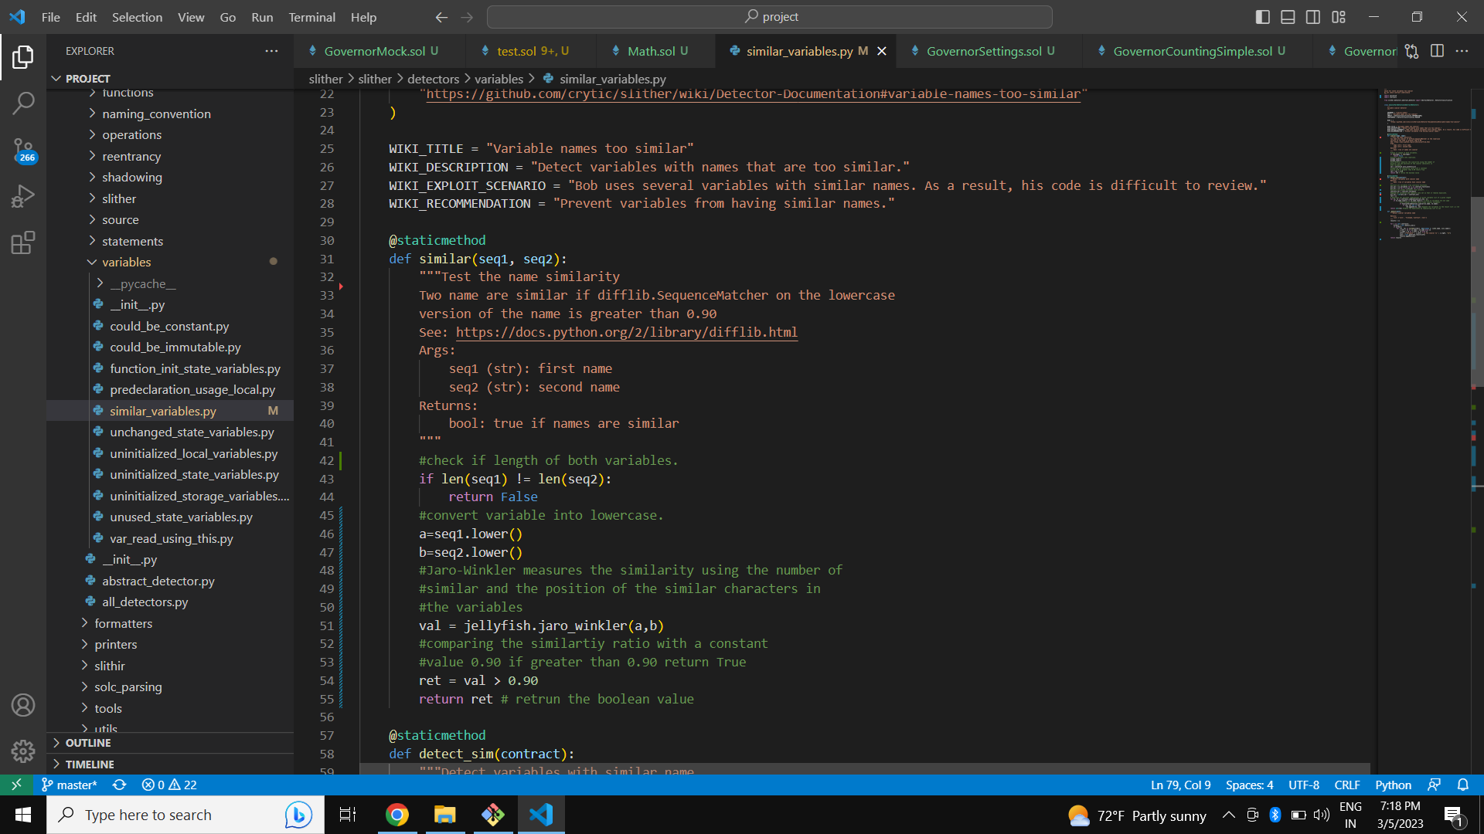
Code Changes and Test contract:
Fig.2 Changes inside similar_variable.py (Jellyfish) [11]

Slide 8
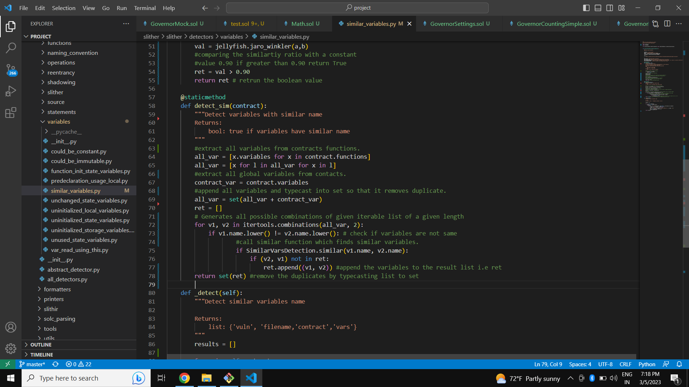
Code changes and Test contract (cont.):
Fig.3 Changes inside similar_variable.py (complexity) [11]

Slide 9
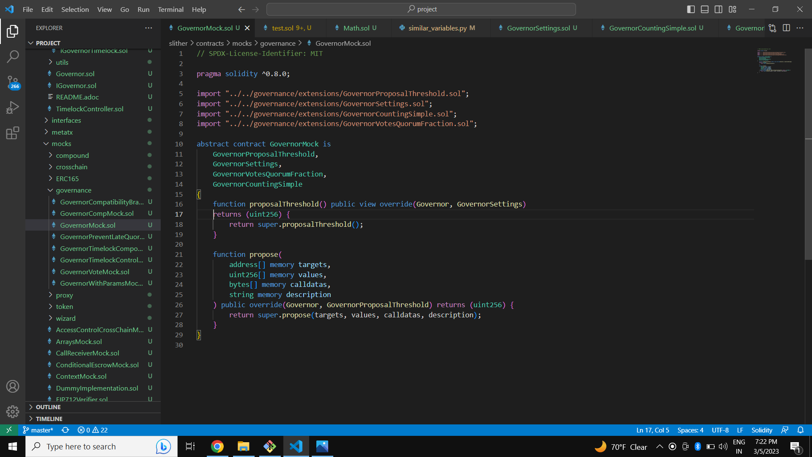
Code Changes and Test contract (cont.):
Fig.4 Test Contract (GovernorMock.sol) [7]

Slide 10
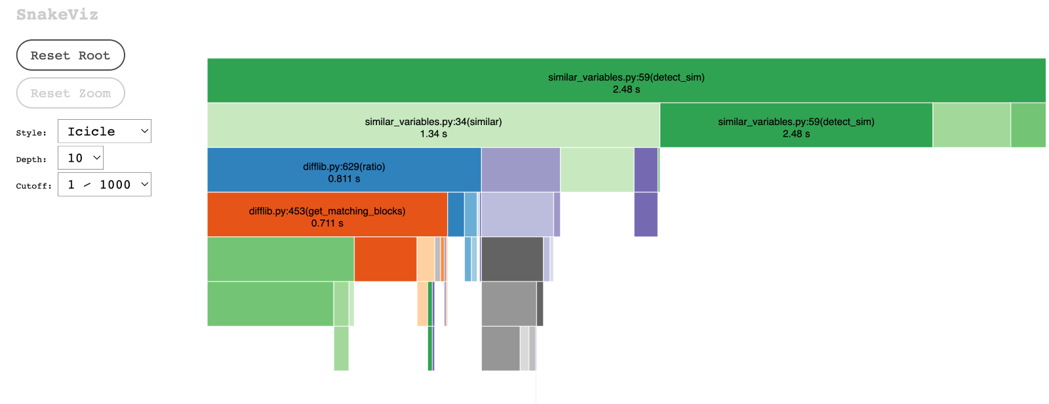
Outputs:
Fig 5. Output before optimizing similar_variable.py [6]

Slide 11
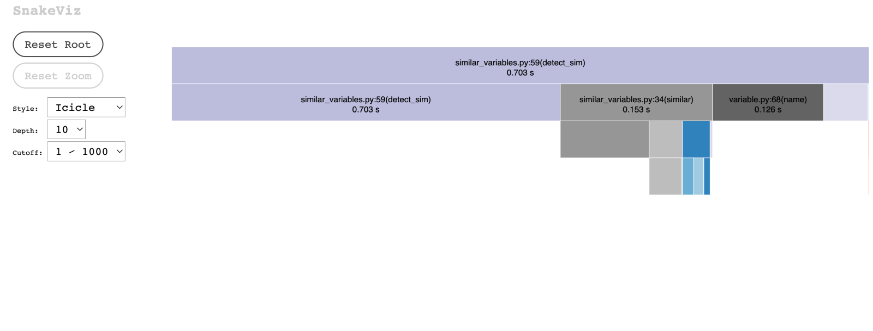
Fig.6 Output after optimizing similar_variable.py [6]

Slide 12
Customers and Users:
The publisher, who posted issue. [2]
Governance jobs(House voting). [7]

Slide 13
Github Repository
https://github.com/shubhammalankar/ASE-CSE-6324-Team-5-Slither

Slide 14
References
[1] https://stackoverflow.com/questions/50487058/python-difflibs-ratio-quick-ratio-and-real-quick-ratio
[2] https://github.com/crytic/slither/issues/1630
[3] https://github.com/crytic/slither/wiki/Developer-installation
[4] https://icons8.com/icons
[5] https://pypi.org/project/jellyfish/
[6] https://jiffyclub.github.io/snakeviz/
[7] https://github.com/OpenZeppelin/openzeppelin-contracts
[8] https://stackoverflow.com/questions/682367/good-python-modules-for-fuzzy-string-comparison
[9] https://pypi.org/project/rapidfuzz/
[10] https://www.python.org/
[11] https://github.com/crytic/slither
[12] https://code.visualstudio.com/

